Slide 1
Using R6 object-oriented programming to build agent-based models
Liam D. Bailey & Alexandre Courtiol
Notes:
Introduction:
I am Liam Bailey, a post doc at the Leibniz Institute for Zoo and Wildlife Research in Berlin
I will be talking about agent based modelling in R with a particular focus on the R6 package

Slide 2

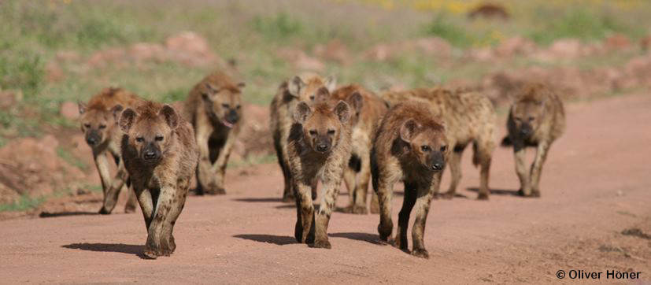

Agent-based modelling
Traffic
Complex animal systems
Disease outbreak
Notes:
What is an agent based model?
Simulate interactions of agents (i.e. individuals) and detect complex emergent properties that would be difficult/impossible to model explicitly.
Great for simulating complex systems
Used in many fields, such as for modelling traffic, disease outbreaks and complex animal systems.

Slide 3
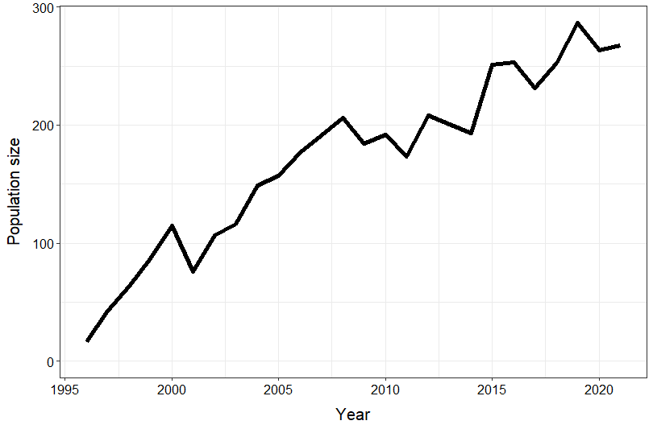
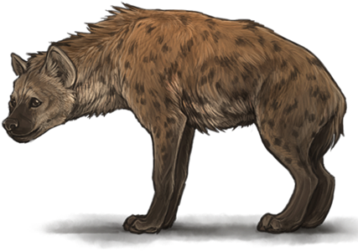
Emergent properties
age = 5
sex = male
age = 1
sex = female
Agents
age = 12
sex = female
Notes:
Imagine we have a population of animals. Each animal is an agent with attributes like age and sex.
We then simulate interactions between our agents.
The way agents interact can be informed by our knowledge of the system in reality.
From our simulation we can then observe complex emergent properties like changing population size.

Slide 4
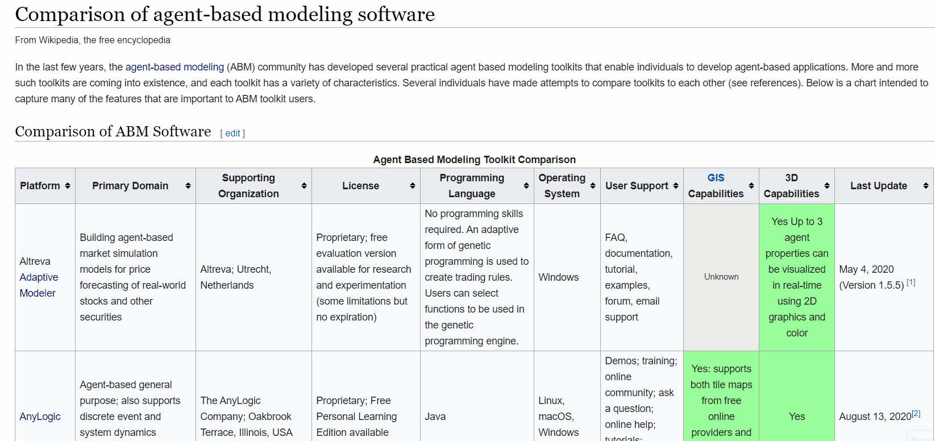
Current tools
Notes:
If you want to do agent-based modelling there are many available tools (https://en.wikipedia.org/wiki/Comparison_of_agent-based_modeling_software).
Many of them are free and open source!

Slide 5
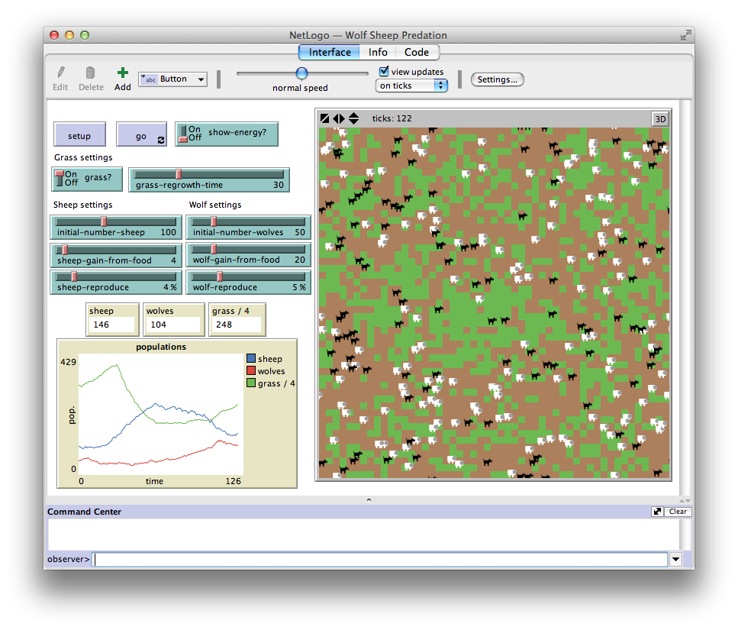
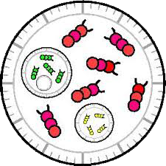


Current tools
NetLogo
SWARM
repast
NetLogo language (inspired by Logo)
Java
Java/C++
Notes:
NetLogo, SWARM, and repast are some of the major tools that are used in biological sciences
All these tools are written in languages other than R, yet R is commonly taught to researchers during their undergraduate so it’s the one they will know best!

Slide 6





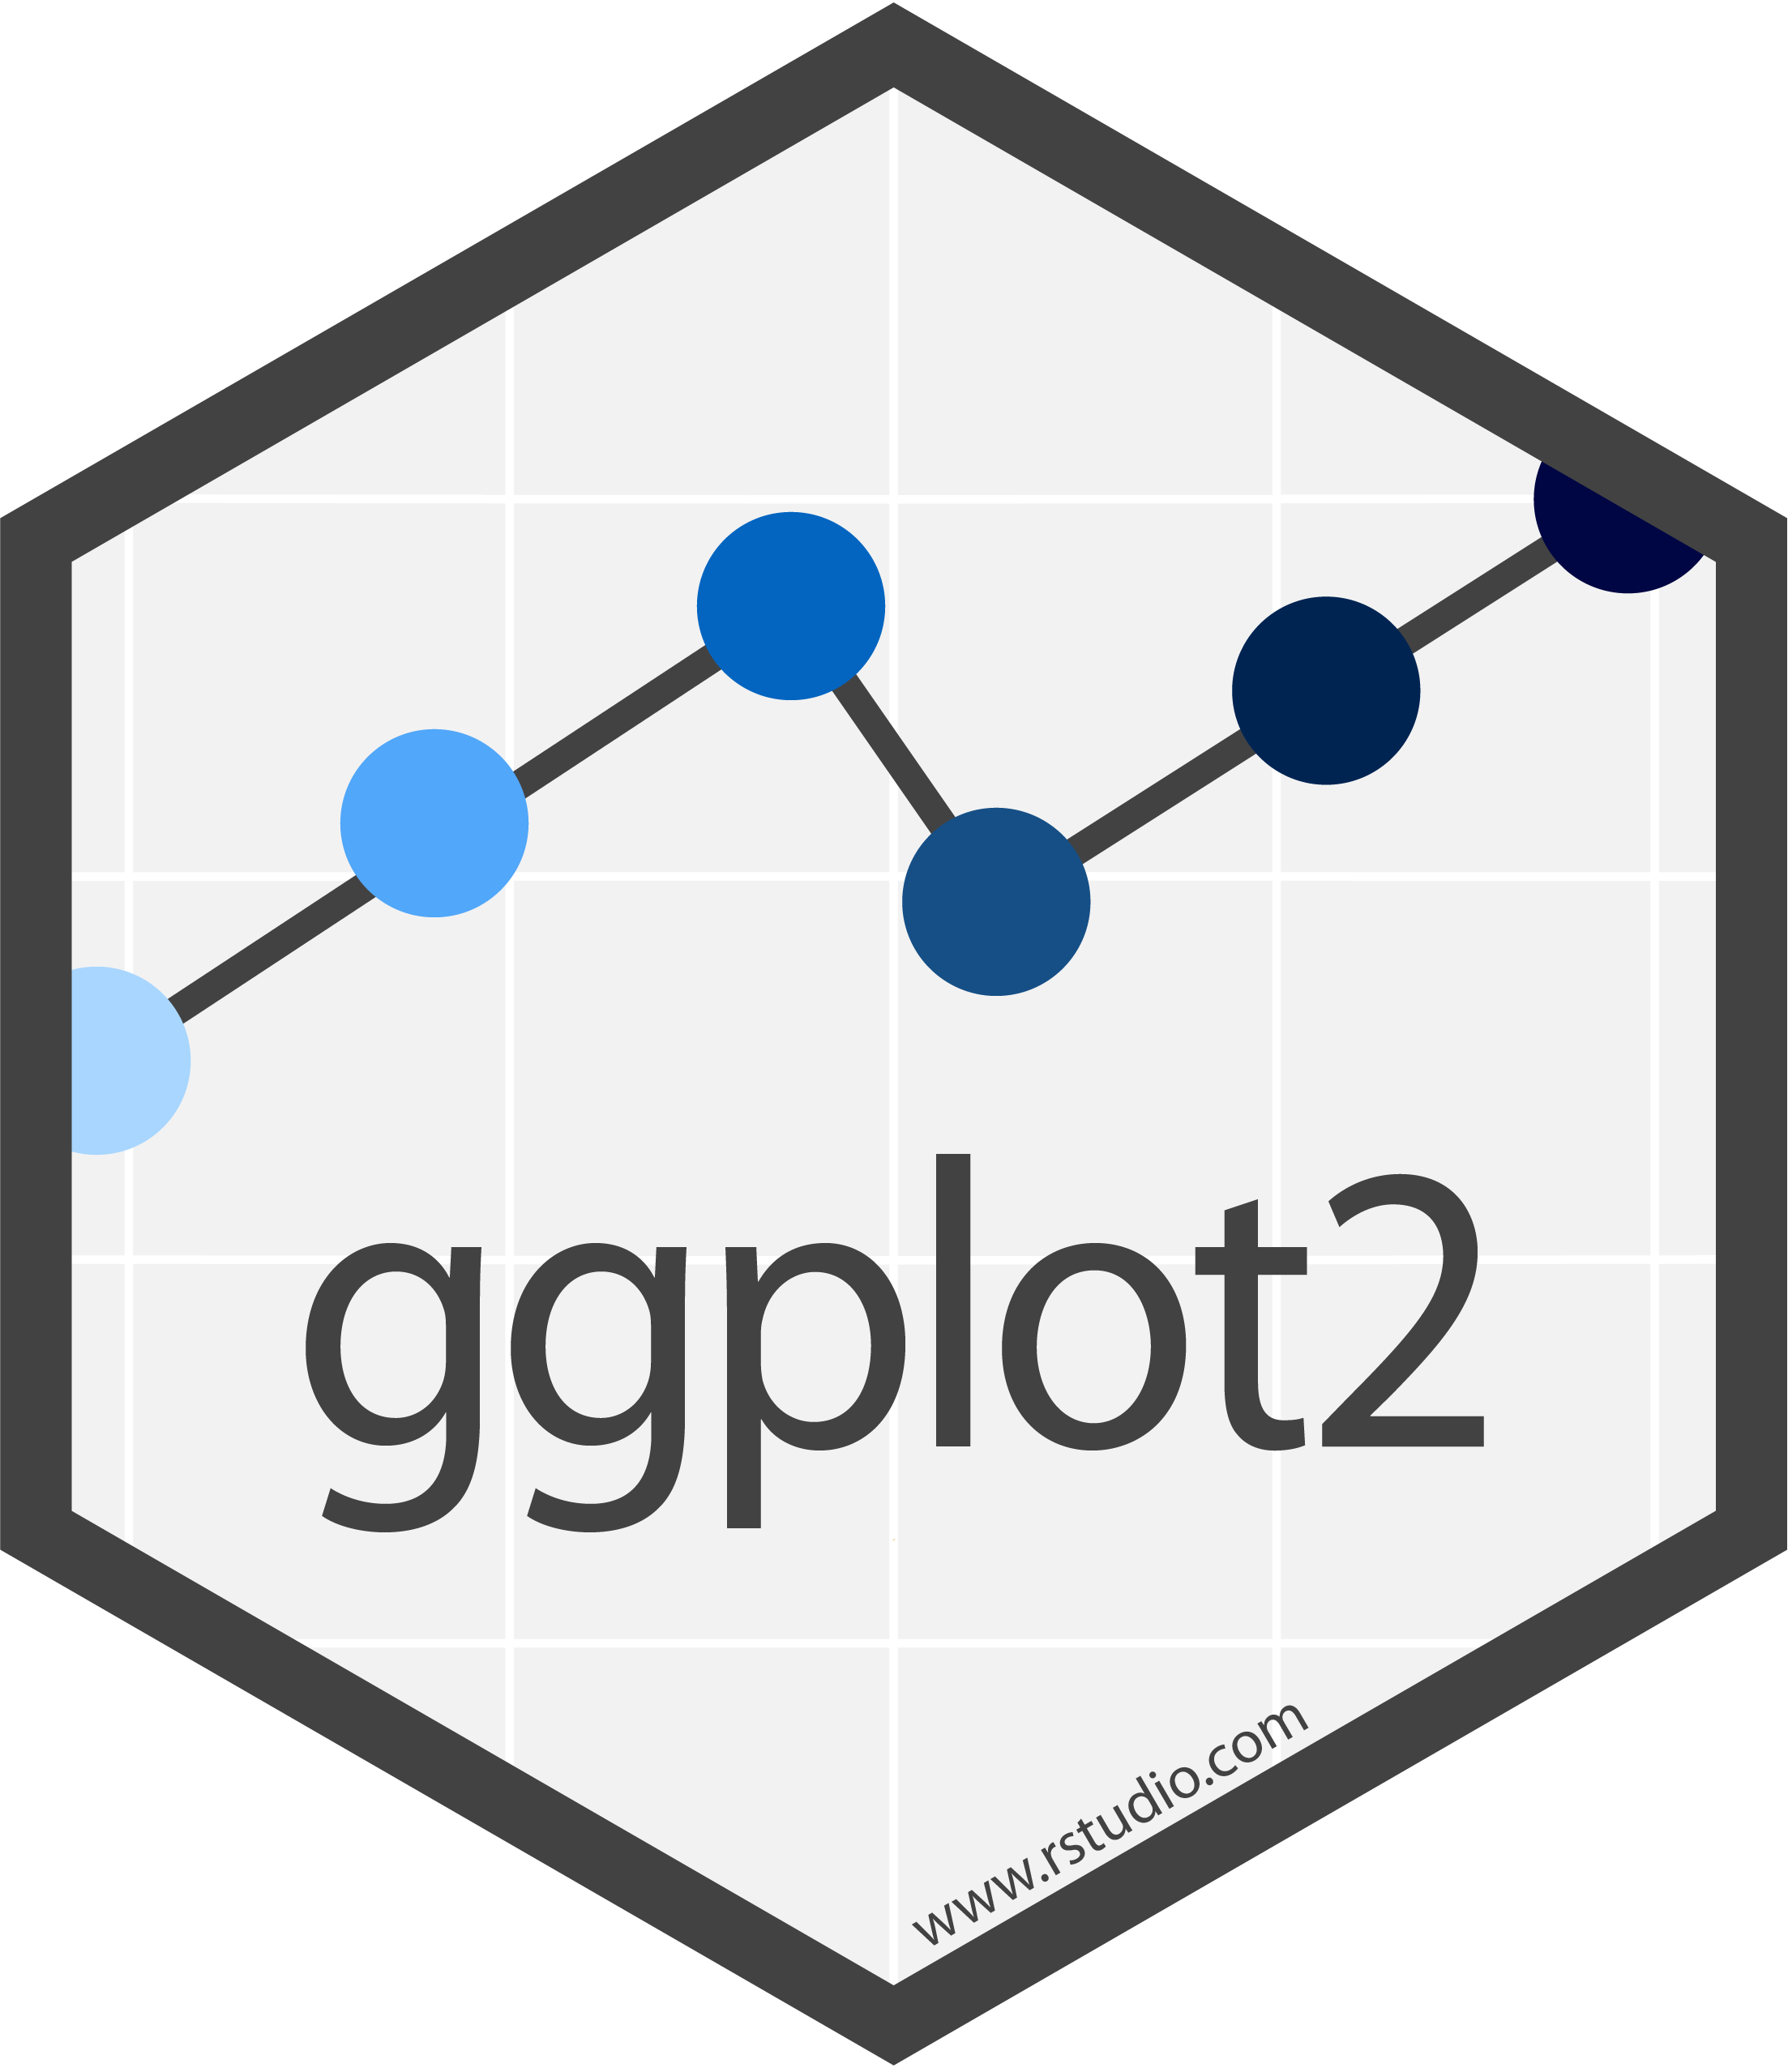



Data wrangling
Statistical modelling
Agent
based modelling
Data visualisation
Notes:
This may be the current workflow for researchers using agent based models.
Data wrangling (dplyr, tidyr, data.table)
Statistical modelling (i.e. spam, ranger)
Agent based modelling outside of R (e.g. Netlogo/SWARM/repast)
Visualisation (ggplot2)

Slide 7


Encapsulated object oriented programming
>350 reverse dependencies
Winston Chang
Notes:
Introducing R6.
Allows for encapsulated object oriented programming, which is also available in Netlogo, Java and C++
Release on CRAN by Winston Chang in 2014
Presented at useR 2017 in Brussels! (https://www.youtube.com/watch?v=tl-cjU_-TDA)
Has reverse dependency with over 350 packages, including major packages like Shiny and dplyr.

Slide 8
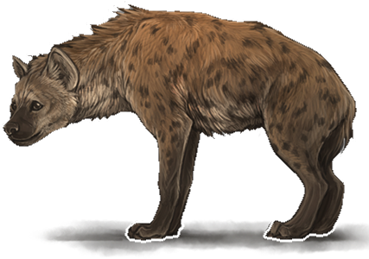
Encapsulated OOP in R
Each object contains attributes and methods
Simple syntax
Fast (enough for our purposes)
#Attributes
sex = "female"
age = 10L
#Methods
grow_old()
have_baby()
Notes:
Encapsulated object oriented programming means that each object has internal attributes (e.g. sex, age) and methods, things that it can do (e.g. ‘grow_old()’, ‘have_baby()’).
It has a simple syntax, to improve upon Reference Classes (native in R).
We have found it fast enough for our purposes.

Slide 9
Compatible with R development tools:
Work in RStudio projects
Documentation with `roxygen2` (≥7.0.0)
Unit testing with `testthat`
Great conceptually and practically for agent-based modelling!
Notes:
Working with R6 allows you to use regular R development tools:
Your agent based model can be built as an Rstudio project
We can document R6 classes using roxygen (>=7.0.0)
We can write unit testing with testthat.
These features make R6 great for agent based modelling in R.

Slide 10
Statistical modelling
Agent
based modelling
Data wrangling
Statistical modelling
Agent
based modelling
Data wrangling
Data visualisation
Data visualisation
Notes:
We can change our agent based modelling workflow to stay within R the whole way!

Slide 11
Data wrangling
Statistical modelling
Agent
based modelling
Data visualisation

Slide 12
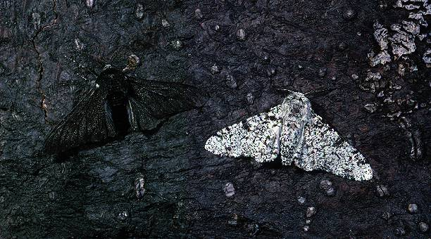

Worked example
data-zoo-gang/ABMR6
Notes:
I will now give a practical example of an agent based model in R.
This live coding will use code available on data-zoo-gang/ABMR6 on GitHub
We will work with the peppered moth. This moth can either be white or black.

Slide 13
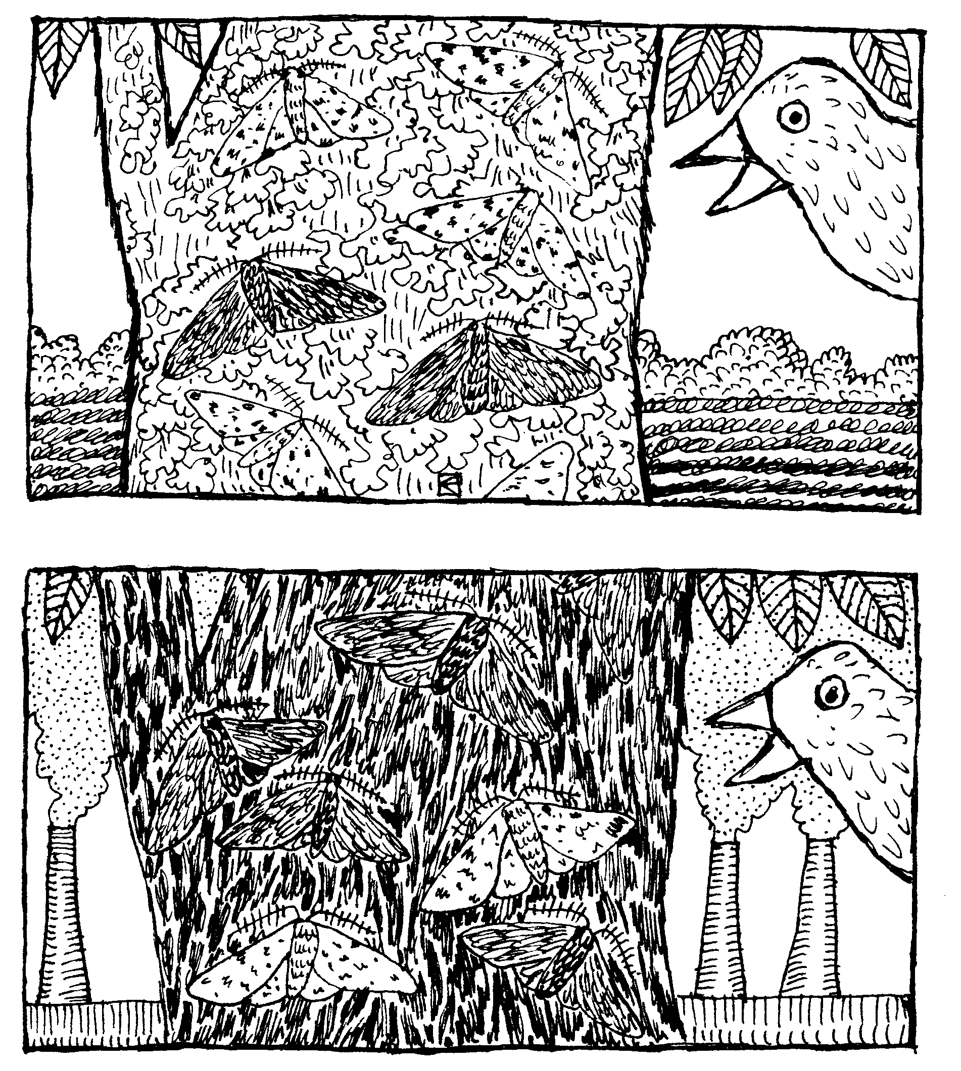
Worked example
data-zoo-gang/ABMR6
Notes:
In the wild, moths are found on white trees. In these environments, white moths are much more common than black moths.
After the industrial revolution, naturalists noticed that pollution was turning trees black. On these trees, black moths were more common that white moths.
We now know this is due to natural selection. Moths are better camouflaged when they match the colour of the tree. This makes it hard for predators, like birds, to spot them.
In our repo, we build an agent based model to recreate this phenomenon. Our model has three simple rules:
Moths do better when they match the colour of their environment.
New moths can be a different colour to their parent with a given probability, defined as a mutation rate.
The world will change colour with a frequency defined by the attribute period.
Please follow the README on the repo ABMR6 to see how this works!

